Slide 1

Banking Project: Risk Analytics
This project applies risk analytics to banking data, building predictive models to classify customer risk levels and support lending decisions.

Slide 2

Problem & Solution
Problem Statement
Analyze customer financial data to identify and classify risk levels, supporting effective risk management and lending decisions.
Solution Overview
Combines Power BI dashboards for descriptive analysis with ML models for predictive risk assessment, enabling data-driven loan approvals.

Slide 3

Dataset & Connectivity
About the Dataset
Database Connectivity
Contains interlinked tables (Banking Relationship, Client-Banking, Gender, Investment Advisor) with bank and client details.
Banking data stored in MySQL, accessed via MySQL Workbench and Python's `pymysql` library for direct querying into Pandas DataFrames.
import pymysql
conn = pymysql.connect(
host="127.0.0.1",
user="root",
password="",
database="banking_Case"
)
print("Connected successfully

Slide 4
Exploratory Data Analysis (EDA)
EDA was crucial for understanding data structure, quality, and patterns to guide feature engineering and modeling.
01
02
Dataset Structure
Univariate Analysis
Examined using `info()`, `describe()`, and `shape` for records, data types, missing values, and distribution.
Analyzed individual variables (age, income, loans) with histograms and bar charts to identify skewness and outliers.
03
04
Bivariate Analysis
Correlation Analysis
Studied relationships between key variables and target features, uncovering patterns like credit utilization and risk.
Used heatmaps to identify relationships among numerical variables and detect multicollinearity, informing feature selection.

Slide 5
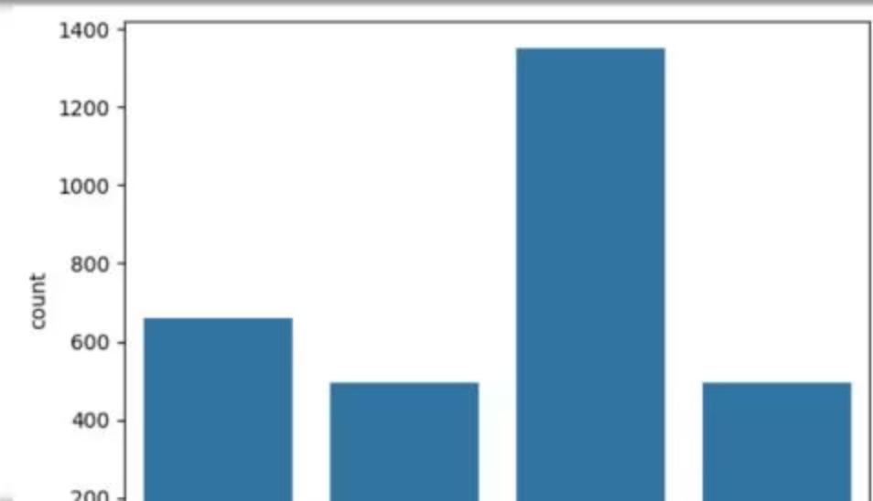
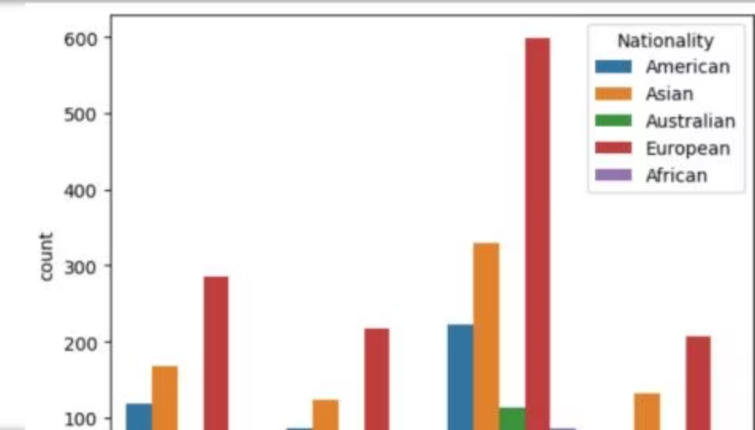
EDA Visualizations
Univariate Distribution
Bivariate Analysis: Nationality
Bar chart showing the distribution of 'Amount of Credit Cards', with the third category having the highest count.
Distribution of a predictor by 'Nationality', with Europeans showing the highest count.

Slide 6
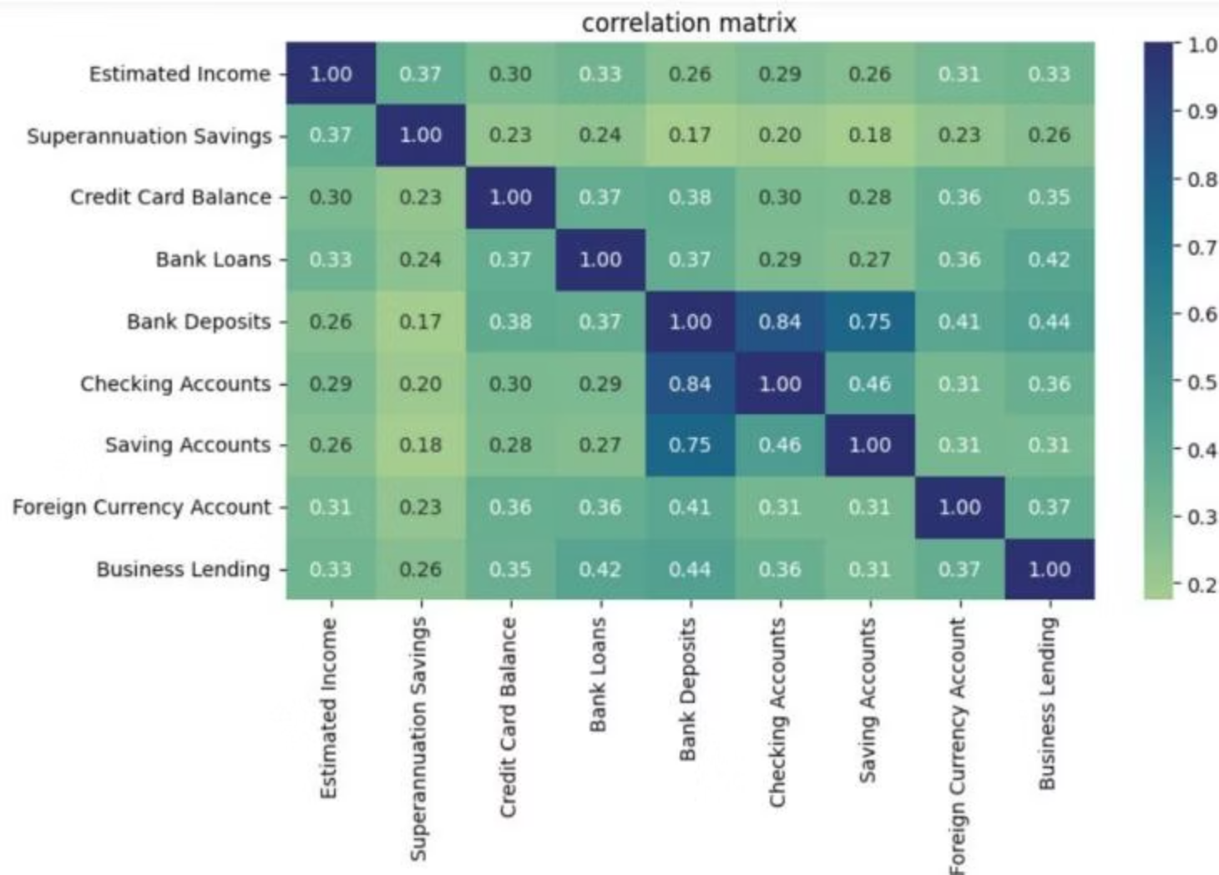
Correlation Matrix
Heatmap revealing relationships between financial variables, crucial for feature selection.
Estimated Income
1.00
0.37
0.30
0.33
0.26
0.29
0.26
0.31
0.33
Bank Loans
0.33
0.24
0.37
1.00
0.37
0.29
0.27
0.36
0.42
Bank Deposits
0.26
0.17
0.38
0.37
1.00
0.84
0.75
0.41
0.44

Slide 7

Power BI Dashboard
Interactive dashboard for visualizing customer profiles and financial patterns.
1
2
Home
Loan Analysis
High-level overview of key metrics and navigation.
Focuses on customer loan behavior and credit exposure.
3
4
Deposit Analysis
Summary, Q&A
Analyzes deposit patterns and savings behavior.
Consolidated insights and interactive data querying.

Slide 8
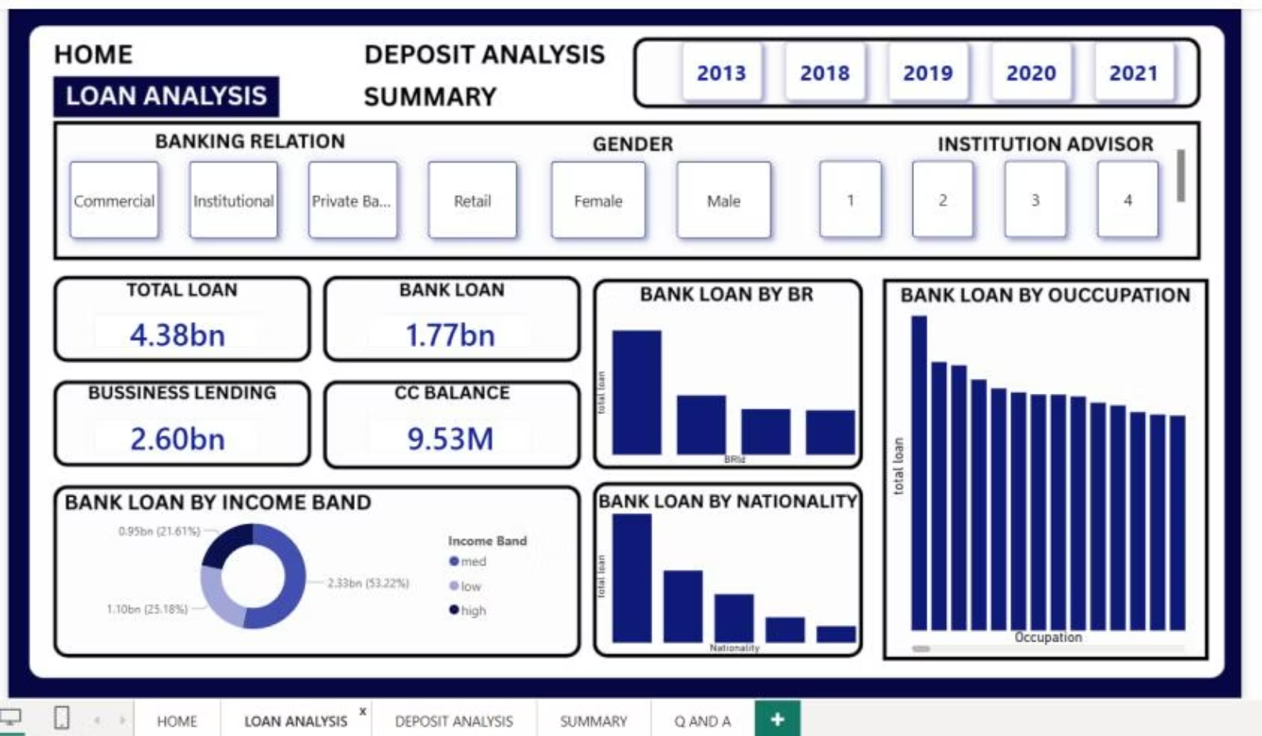
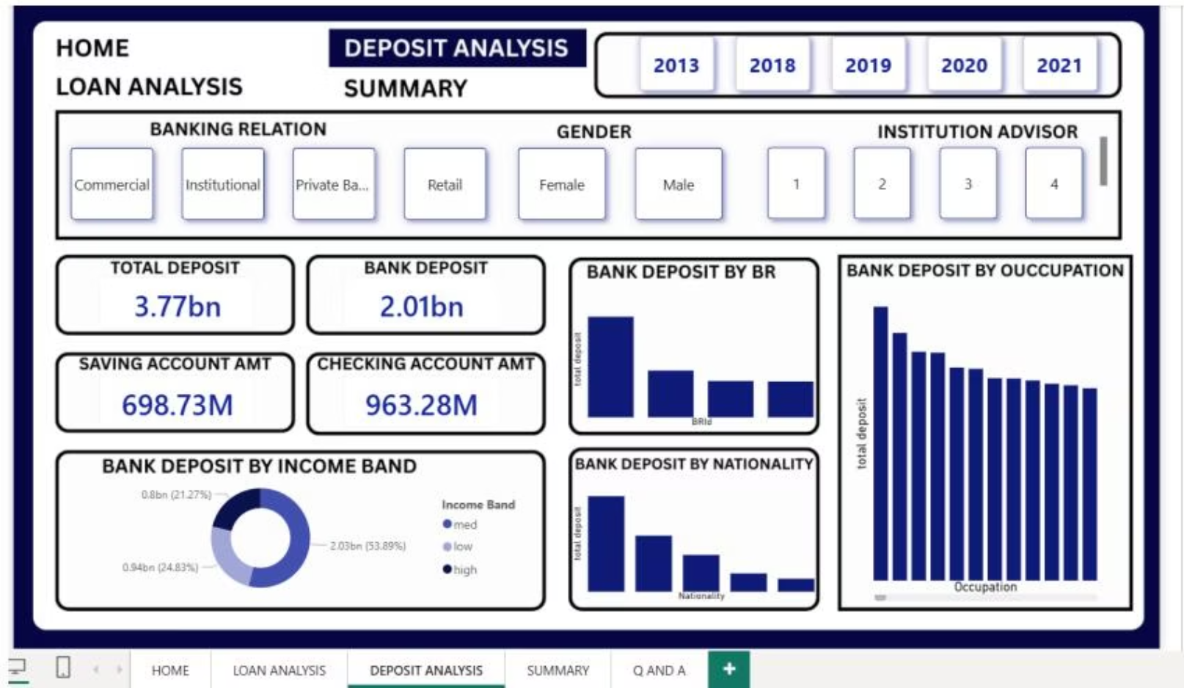
Loan & Deposit Insights
Loan Analysis Dashboard
Deposit Analysis Dashboard
Visualizes loan distribution by banking relation, occupation, income band, and nationality.
Illustrates deposit patterns by banking relation, occupation, income band, and nationality.

Slide 9





Machine Learning Methodology
A pipeline to predict customer risk levels based on financial and demographic attributes.
Feature Engineering
Created Total Balance, Credit Utilization, and Loan-to-Income Ratio.
Data Preparation
Encoded categorical variables and standardized numerical features.
Model Development
Implemented Logistic Regression, Random Forest, and Gradient Boosting.
Model Evaluation
Evaluated using accuracy, precision, recall, F1-score, and ROC-AUC.

Slide 10
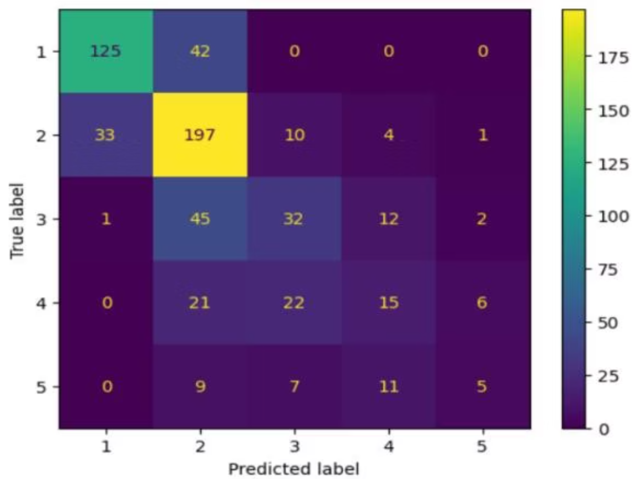
ML Outcome & Future
Gradient Boosting Performance
Future Scope
Demonstrated superior performance in classifying risk categories.
Deploy model as a web application for real-time assessment.
Integrate explainable AI (SHAP) for transparency.
Expand dataset with real-time data for better generalization.
Automate data pipelines for continuous retraining.
Extend to credit scoring, customer segmentation, fraud detection.
ROC-AUC: 0.8546724217082096

